Slide 1
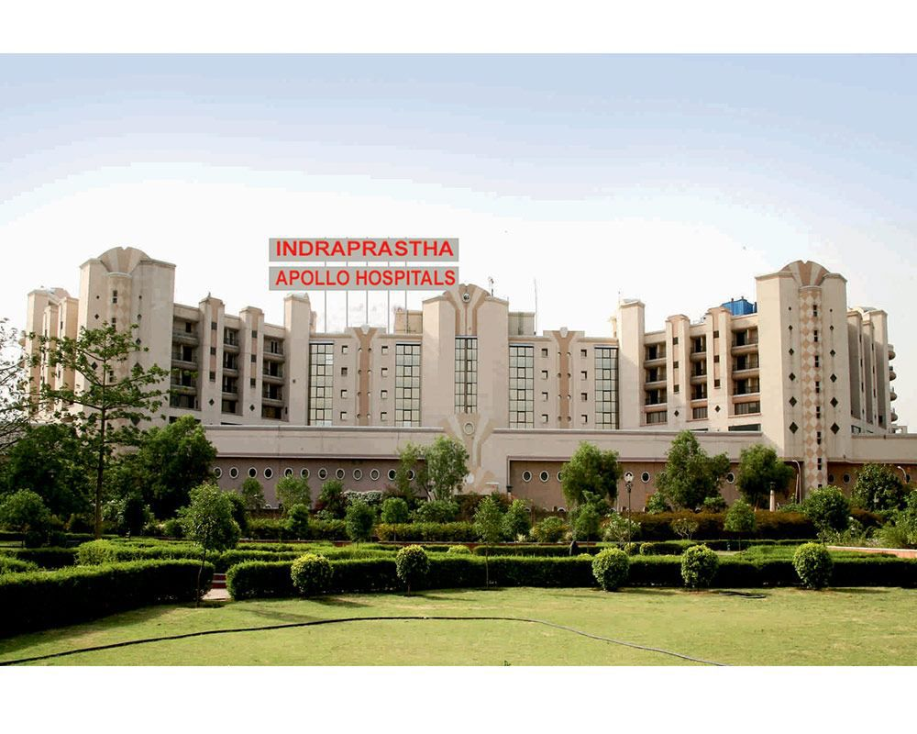

Internship presentation
Apollo hospital, sarita vihar-Delhi
Kashish thakur
Bba ghcm
2k24mcun03005

Slide 2
About us
* Apollo Hospitals is one of India's leading healthcare organizations. Provides advanced medical care, patient-centric services, and healthcare innovation.Accredited by international quality standards and focused on continuous improvement in patient safety and healthcare excellence. Apollo Hospital Sarita Vihar is known for its multidisciplinary healthcare services and commitment to quality healthcare delivery.

Slide 3
department-learning and development(l&d) job role-intern
Role Overview
During my internship, I assisted the Learning & Development team in managing training-related activities, maintaining employee records, and supporting organizational learning initiatives.
*Key Responsibilities*
Handling paramedic and support staff training data.
Maintaining employee training records.
Assisting in Training Management System (TMS) operations.
Supporting departmental documentation and reporting activities.
Coordinating training-related administrative tasks.

Slide 4
Learning & Development Systems Exposure
About Training Management System (tms)
Work Performed
Data entry and record maintenance.
Updating employee training status.
Generating training-related reports.
Ensuring accuracy and completeness of training records.
Skills Developed
Data Management
Documentation Control
Report Preparation
Database Handling

Slide 5
Training Programs Supported
Hazmat driil
Apollo incident reporting system training
jci refresher training
A *HAZMAT Drill* is a mock emergency exercise conducted to prepare hospital staff for incidents involving hazardous substances such as: Chemical spills,Toxic gas exposure ,Biological hazards, Radioactive contamination
Objective of the drill:
Test emergency preparedness
Practice use of Personal Protective Equipment (PPE)
Ensure patient, staff, and visitor safety
The *Apollo Incident Reporting System (AIRS)* is an online patient safety reporting system used across Apollo Hospitals. It helps staff report and track incidents that may affect the safety of patients, visitors, or employees.
purpose of AIRS is to:
Promote a culture of safety
Identify risks early
Prevent recurrence of incidents
JCI (Joint Commission International) Refresher Training* is periodic training conducted to ensure hospital staff remain compliant with international healthcare quality and patient safety standards.
Objectives of JCI Training
Maintains accreditation standards
Improves patient safety
Enhances quality of care
Keeps staff updated on hospital policies and procedures

Slide 6
Key Learnings and Professional Development
Knowledge Gained
Professional Skills Developed
. Understanding hospital training and compliance processes.
Importance of employee development in healthcare organizations.
Exposure to healthcare accreditation standards such as JCI.
Understanding emergency preparedness activities like HAZMAT drills
Learning systematic data management and documentation practices.
Attention to Detail
Time Management
Team Collaboration
Organizational Skills
Professional Work Ethics

Slide 7


